Slide 1


SQL

Slide 2
TABLE OF CONTENTS
01
02
03
An Introduction to Relational Databases And SQL
Using the Management Studio
Retrieving Data from a Single Table

Slide 3

Client/Server Systems

Slide 4

Why Database?
DATA
Login/Sign up
Location
Cuisines
Restaurants
Reviews
ETA

Slide 5





Database Servers
Database servers offer a centralized and structured approach to data storage and retrieval.
Data Storage
Query Processing
Data Security
Data Integrity
Transaction Management
Indexing

Slide 6
Database Use Case
Database
Storage
Query

Slide 7




Query
CREATE
READ
Create/add/insert a new Record.
Ex: Add a new restaurant on its website.
Retrieve Data
Ex: Users can see all the restaurants listed in the website.
QUERY
DELETE
Changing existing Record.
Ex: User updates his/her location.
Deleting an existing Record
Ex: The website deletes an old restaurant.

Slide 8
Structured vs Unstructured Data
Structured data | Unstructured data
Organised data in tables, columns, and relationships | Cannot be Organised data in tables, columns, and relationships
Use Case: Customer Details, Employee Details | Use Case: Image, audio file, emails
About 20% enterprise data | More than 80% enterprise data
Less storage required | Requires more storage
Easier to process information | Difficult to manage and process

Slide 9
Types of Databases
Hierarchical
Databases
Network Database
Object-oriented Database
Relational Database
NoSQL Databases

Slide 10
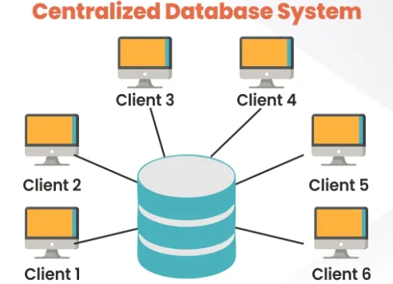
Centralized Databases

Slide 11
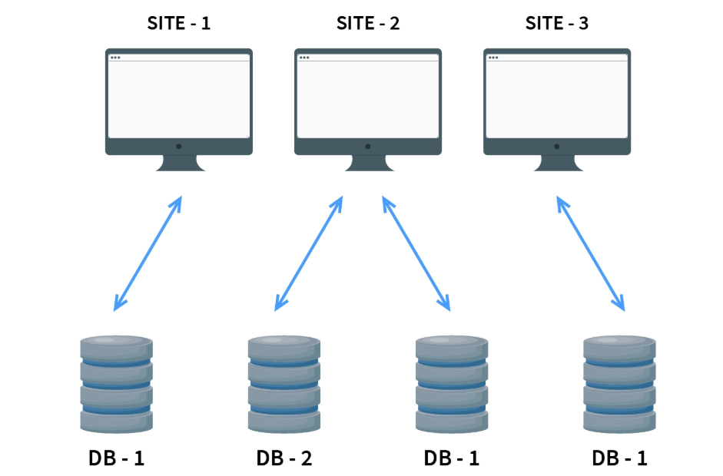
Distributed Databases
HOMOGENEOUS Distributed Databasesc

Slide 12
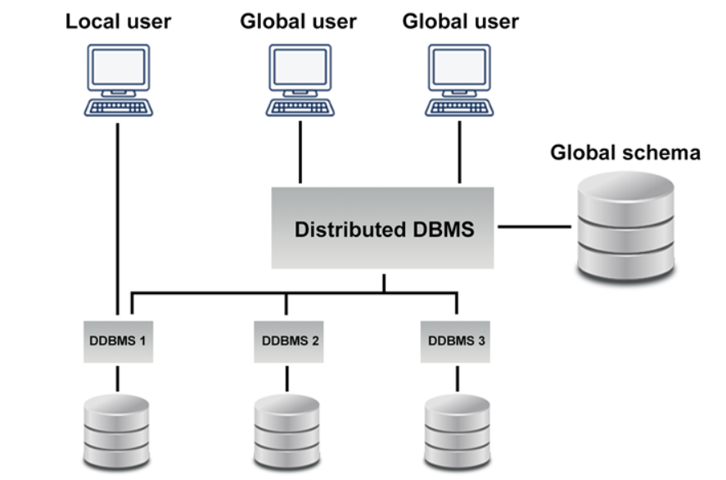
Distributed Databases
HETEROGENEOUS Distributed Databases

Slide 13
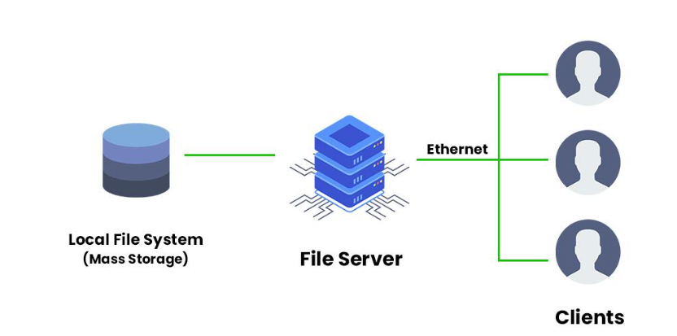
File-server databases

Slide 14

Client-server databases

Slide 15
Structured vs Unstructured Data
Structured Data
Relational Databases
Unstructured Data
NoSQL Databases

Slide 16
Relational vs NoSQL Databases
Relational Database | NoSQL Database
Data items have pre-defined relationships between them | Uses a storage model optimised for specific requirements of the type of data being stored
Information is stored in structured tables with rows and columns | Document, key-value
Ex: MySQL, Microsoft SQL Server | Ex: Mongo DB, Apache Cassandra

Slide 17
SQL
SQL (Structured Query Language) is a programming language used to manage and manipulate relational databases.
It allows users to interact with databases by querying, updating, and managing data, making it a fundamental tool for working with structured data.

Slide 18
RDBMS
Data | Database | Database Management system
Information | Storage of information | Software that helps in performing CRUD operations to data in the database
Relational Data | Database | Database Management system
Data has relationship | Database that stores structured and relational data | Software that helps in performing CRUD operations to structured data in the relational database

Slide 19
RDBMS
SQL-based systems, also known as Relational Database Management Systems (RDBMS), are software applications that use SQL to manage relational databases.
They provide a platform for creating and maintaining databases, as well as executing SQL commands to manage data stored in those databases.

Slide 20
Relational Database Model
The relational database model is a method of structuring and organizing data in a database, where data is stored in tables with rows and columns.
Each table represents an entity, and relationships between entities are established using keys.
This model allows for efficient data retrieval, data integrity, and easy management of complex data structures.

Slide 21
Scenario for RDBMS
Strict Schema
Relational data
Transactional Requirements
When data can be stored on a single server
Banking → Money transaction system
Money Wallet → Google Pay, PhonePe
E-commerce → Payments, users, etc
Restaurant Listing → Zomato
Employee Management Software
Twitter → Tweets and Users
YouTube

Slide 22
Features for RDBMS
ENTITY
TABULAR STRUCTURE
COLUMNS
FIELDS
EMP_ID | NAME | D_ID | SALARY
1 | Alice | D01 | 50000
2 | Bob | D02 | 60000
3 | Chris | D03 | 70000
RECORD OR ROWS

Slide 23
Features for RDBMS
EMPLOYEE
DEPARTMENT
EMP_ID | NAME | D_ID | SALARY
1 | Alice | D01 | 50000
2 | Bob | D02 | 60000
3 | Chris | D03 | 70000
D_ID | D_NAME
D01 | Account
D02 | HR
D03 | Sales

Slide 24
Features for RDBMS
Keys
Super Key
Candidate Key
Primary Key
Alternate Key
Unique Key
Foreign Key

Slide 25
Keys
A key is a set of one or more attributes that uniquely identify a row in a table, ensuring data integrity and providing efficient data retrieval.
emp_id | name | aadhar | salary | contact | email
1 | John | 123456789012 | 50000.00 | 9876543210 | john.doe@example.com
2 | Jane | 987654321012 | 60000.00 | NULL | jane.smith@example.com
3 | Michael | 456789012345 | 55000.00 | 9876543212 | michael.johnson@example.com
4 | John | 789012345678 | 52000.00 | 9876543213 | NULL

Slide 26
Keys
SUPER KEYS
emp_id | name | aadhar | salary | contact | email
1 | John | 123456789012 | 50000.00 | 9876543210 | john.doe@example.com
2 | Jane | 987654321012 | 60000.00 | NULL | jane.smith@example.com
3 | Michael | 456789012345 | 55000.00 | 9876543212 | michael.johnson@example.com
4 | John | 789012345678 | 52000.00 | 9876543213 | NULL
A super key is a set of one or more attributes that can uniquely identify a row in a table.
Ex:
emp_id
Aadhar
(emp_id, name)
(emp_id,aadhar)
(emp_id, name, salary)

Slide 27
Keys
CANDIDATE KEYS
emp_id | name | aadhar | salary | contact | email
1 | John | 123456789012 | 50000.00 | 9876543210 | john.doe@example.com
2 | Jane | 987654321012 | 60000.00 | NULL | jane.smith@example.com
3 | Michael | 456789012345 | 55000.00 | 9876543212 | michael.johnson@example.com
4 | John | 789012345678 | 52000.00 | 9876543213 | NULL
A candidate key is a minimal super key.
Ex:
emp_id
Aadhar

Slide 28
Features for RDBMS
PRIMARY KEY
emp_id | name | aadhar | salary | contact | email
1 | John | 123456789012 | 50000.00 | 9876543210 | john.doe@example.com
2 | Jane | 987654321012 | 60000.00 | NULL | jane.smith@example.com
3 | Michael | 456789012345 | 55000.00 | 9876543212 | michael.johnson@example.com
4 | John | 789012345678 | 52000.00 | 9876543213 | NULL
A primary key is a unique identifier for each record in a database table, ensuring that no two records have the same key.
Ex:
emp_id or aadhar
Let’s consider emp_id as PK.

Slide 29
Keys
ALTERNATE KEYS
An alternate key is a candidate key that is not selected as the primary key but can still uniquely identify each row in a table.
Ex:
emp_id if aadhar is PK
aadhar if emp_id is PK
In our case, aadhar is the AK.
emp_id | name | aadhar | salary | contact | email
1 | John | 123456789012 | 50000.00 | 9876543210 | john.doe@example.com
2 | Jane | 987654321012 | 60000.00 | NULL | jane.smith@example.com
3 | Michael | 456789012345 | 55000.00 | 9876543212 | michael.johnson@example.com
4 | John | 789012345678 | 52000.00 | 9876543213 | NULL

Slide 30
Keys
UNIQUE KEYS
emp_id | name | aadhar | salary | contact | email
1 | John | 123456789012 | 50000.00 | 9876543210 | john.doe@example.com
2 | Jane | 987654321012 | 60000.00 | NULL | jane.smith@example.com
3 | Michael | 456789012345 | 55000.00 | 9876543212 | michael.johnson@example.com
4 | John | 789012345678 | 52000.00 | 9876543213 | NULL
A unique key, like a primary key, is used to uniquely identify each row in a table. However, unlike a primary key, a unique key can allow one or more NULL values.
Ex:
contact
email

Slide 31
Keys
FORIEGN KEY
EMPLOYEE
DEPARTMENT
EMP_ID | NAME | D_ID | SALARY
1 | Alice | D01 | 50000
2 | Bob | D02 | 60000
3 | Chris | D03 | 70000
D_ID | D_NAME
D01 | Account
D02 | HR
D03 | Sales
A foreign key is a field in a database table that refers to the primary key of another table, establishing a relationship between the two tables.
Ex: D_ID in Employee table as a FK

Slide 32
Design a Data Structure
Step | Description
1 | Understand Requirements: Understand the data storage and processing requirements.
2 | Choose the Right Data Structure: Select the appropriate data structure for needs.
3 | Define Data Elements: Identify the fields (data elements) for each record/entry.
4 | Design Relationships: Determine relationships between data elements/entities.
5 | Handle Data Constraints: Consider data constraints like uniqueness and data types.
6 | Optimize for Performance: Design to optimize performance for common operations.
7 | Handle Data Growth: Plan for scalability to handle growing data volume.
8 | Test and Refine: Thoroughly test and refine the data structure design.
9 | Document Your Design: Document the design details for future reference.
10 | Implement and Maintain: Implement the design and maintain it over time.

Slide 33
Normalize a Data Structure
Normalizing a data structure involves organizing data into multiple related tables to reduce redundancy and improve data integrity. There are several steps to achieve data normalization, often referred to as normal forms.

Slide 34
Normalize a Data Structure
First Normal Form
(1NF)
Second Normal Form (2NF)
- Eliminate duplicate columns.
- Create a primary key for each table.
- Ensure each column holds atomic (indivisible) values.
- Meet the requirements of 1NF.
- Remove partial dependencies by splitting the table into smaller tables where each non-key attribute depends on the whole primary key.

Slide 35
Normalize a Data Structure
Third Normal Form
(3NF)
Boyce-Codd Normal Form (BCNF)
- Meet the requirements of 2NF.
- Remove transitive dependencies by moving attributes that depend on non-key attributes to separate tables.
- Meet the requirements of 3NF.
- Ensure that each determinant (attribute that determines another attribute) is a candidate key.

Slide 36
Normalize a Data Structure
Fourth Normal Form
(4NF)
Fifth Normal Form
(5NF)
- Meet the requirements of BCNF.
- Remove multi-valued dependencies by creating separate tables for multi-valued attributes.
- Meet the requirements of 4NF.
- Eliminate join dependencies, ensuring that a table can be reconstructed from two or more other tables.

Slide 37
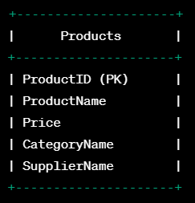
Normalize a Data Structure

Slide 38
Normalize a Data Structure
What’s wrong here?
ProductID | ProductName | Category | Supplier | Price
1 | Laptop | Electronics | Supplier A | 800
2 | T-Shirt | Clothing | Supplier B | 25
3 | Smartphone | Electronics | Supplier A | 600
4 | Jeans | Clothing | Supplier C | 40

Slide 39
Normalize a Data Structure
First Normal Form (1NF)
- Eliminate duplicate columns.
- Create a primary key for each table.
- Ensure each column holds atomic (indivisible) values.
ProductID | ProductName | Price
1 | Laptop | 800
2 | T-Shirt | 25
3 | Smartphone | 600
4 | Jeans | 40

Slide 40
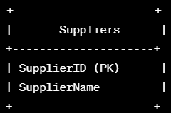
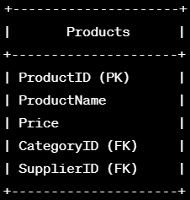
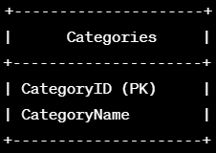
Normalize a Data Structure
- Meet the requirements of 1NF.
- Remove partial dependencies by splitting the table into smaller tables where each non-key attribute depends on the whole primary key.

Slide 41
Normalize a Data Structure
Second Normal Form (2NF)
SupplierID | SupplierName
101 | Supplier A
102 | Supplier B
103 | Supplier C
ProductID | ProductName | Price | CategoryID | SupplierID
1 | Laptop | 800 | 201 | 101
2 | T-Shirt | 25 | 202 | 102
3 | Smartphone | 600 | 201 | 101
4 | Jeans | 40 | 202 | 103
CategoryID | CategoryName
201 | Electronics
202 | Clothing
203 | Furniture

Slide 42
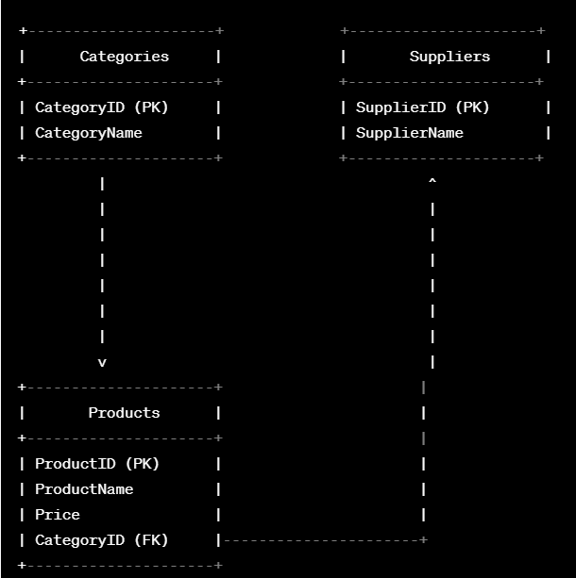
Normalize a Data Structure

Slide 43
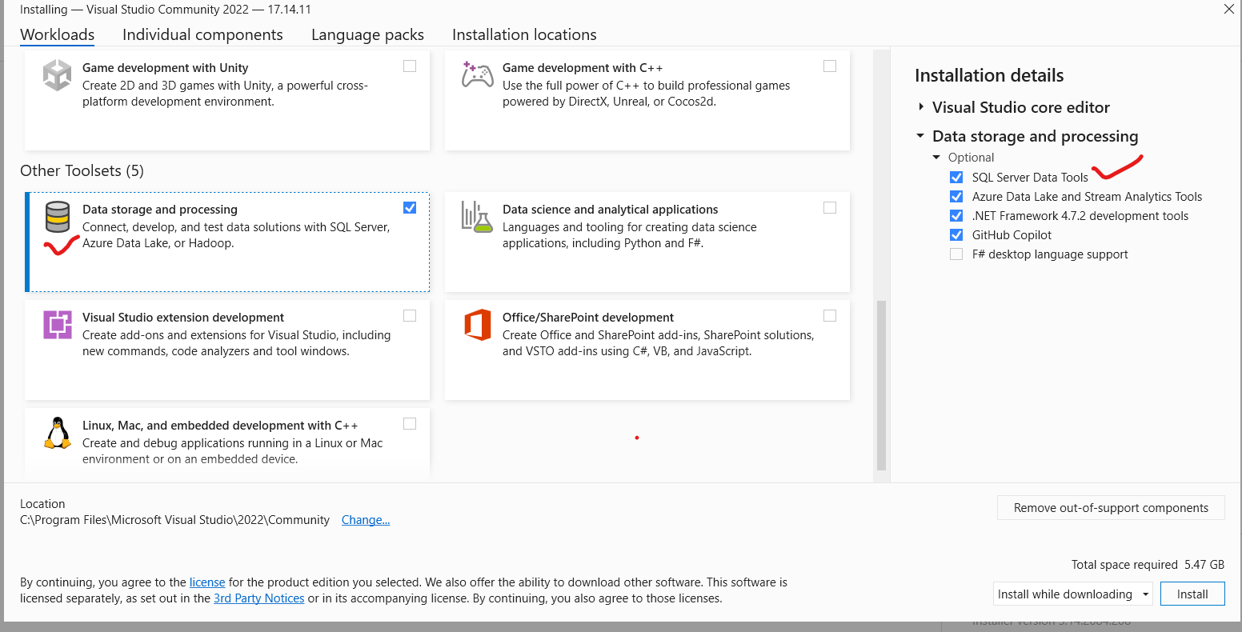
E-R- Diagram

Slide 44
SQL Server 2022
SQL Server 2022 is a widely used relational database management system developed by Microsoft.
SQL Server 2022 is a popular choice for enterprise applications, web applications, business intelligence, and data warehousing.

Slide 45
Management Studio
SQL Server Management Studio (SSMS) is a powerful integrated environment provided by Microsoft for managing and working with SQL Server databases.
It is a graphical user interface (GUI) tool that allows database administrators, developers, and users to perform various tasks related to SQL Server.

Slide 46
Transact-SQL statements
Transact-SQL (T-SQL) is a proprietary extension of SQL used in Microsoft SQL Server.
It includes additional features and enhancements to standard SQL, allowing developers to perform more complex tasks and interact with SQL Server databases more effectively.

Slide 47
Transact-SQL statements
BEGIN TRANSACTION;
UPDATE Accounts SET Balance = Balance - 150 WHERE AccountID = 'A'; UPDATE Accounts SET Balance = Balance + 150 WHERE AccountID = 'B’; COMMIT;
ROLLBACK;

Slide 48
Transact-SQL statements
SAVE Transaction SP1; DELETE FROM Student WHERE AGE = 20; SAVE Transaction SP2;
ROLLBACK Transaction SP1;

Slide 49
Transact-SQL statements
Best Practices for Managing SQL Transactions
While SQL transactions are powerful, they require careful management to ensure optimal performance and avoid problems like transaction blocking and unnecessary locks. Here are some best practices:
Keep Transactions Short: Avoid long-running transactions as they can lock tables and reduce concurrency.
Use Proper Indexing: Proper indexing on tables involved in the transaction can greatly improve performance.
Avoid Transaction Blocking: Ensure transactions don’t block others unnecessarily, causing delays.
Commit Early: Try to commit as soon as the transaction is complete to release resources.

Slide 50


Transact-SQL statements
Top with Ties Clause
Common Table Expressions
Output Clause
WITH SalesCTE AS (
SELECT ProductID, SUM(Quantity) AS TotalSales
FROM Sales
GROUP BY ProductID
)
SELECT * FROM SalesCTE;
INSERT INTO Employees (FirstName, LastName)
OUTPUT INSERTED.EmployeeID, INSERTED.FirstName, INSERTED.LastName INTO AuditTable
VALUES ('John', 'Doe');

Slide 51
Transact-SQL statements
Data Definition Language-DDL
Data Definition Language (DDL) is used to work with the schema of the database.
SQL Statement | Description
CREATE | Used to create new database objects such as tables, views, and stored procedures.
ALTER | Used to modify existing database objects, like adding or removing columns from a table.
DROP | Used to remove database objects from the database.
RENAME | Used to rename database objects.

Slide 52
Transact-SQL statements
Data Manipulation Language-DML
Data Manipulation Language (DML) is used to modify the data in the database.
Command | Description
INSERT | Adds new records into a table.
UPDATE | Modifies existing records in a table.
DELETE | Removes records from a table.

Slide 53
Transact-SQL statements
Data Query Language-DQL
DQL (Data Query Language) is used to query the data in the database.
DQL Command | Description
SELECT | Retrieves data from one or more tables.

Slide 54
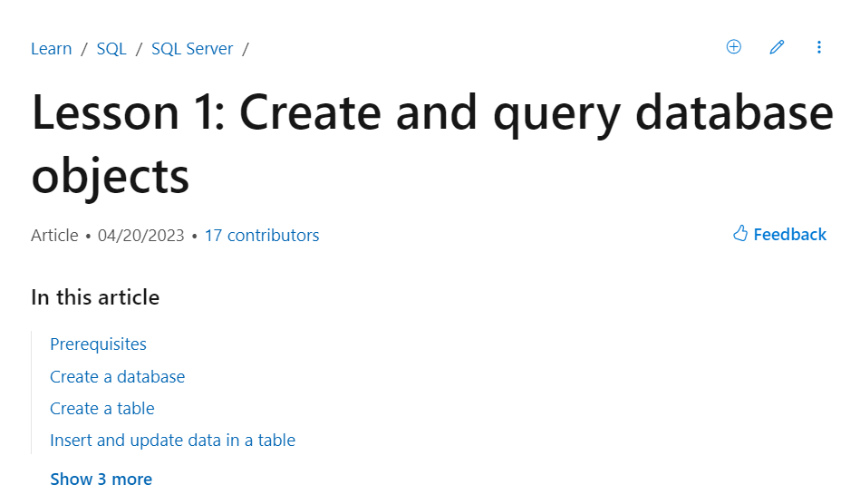
How to view the documentation for SQL Server
https://learn.microsoft.com/en-us/sql/t-sql/lesson-1-creating-database-objects?view=sql-server-ver16

Slide 55

CREATE DATABASE
The keyword GO separates statements when more than one statement is submitted in a single batch. GO is optional when the batch contains only one statement.
CREATE DATABASE TestData
GO

Slide 56
USE DATABASE
This command changes your connection to the TestData database.
USE TestData
GO

Slide 57
Data Types
Data Type | Description | Example | Limit/Size
INT | Represents whole numbers between -2^31 and 2^31-1. | EmployeeID INT | -2,147,483,648 to 2,147,483,647
SMALLINT | Represents whole numbers between -2^15 and 2^15-1. | Age SMALLINT | -32,768 to 32,767
TINYINT | Represents whole numbers between 0 and 255. | IsActive TINYINT | 0 to 255
VARCHAR | Variable-length character strings with max length 'n'. | FirstName VARCHAR(50) | 50
DECIMAL | Fixed-point decimals with 'p' total digits and 's' decimal places. | Salary DECIMAL(10, 2) | 10 (total digits) / 2 (decimal places)

Slide 58
Data Types
Data Type | Description | Example
DATE | Represents a date (year, month, day). | HireDate DATE
TIME | Represents a time of day (hour, minute, second). | LastLogin TIME
DATETIME | Represents a date and time. | DateTime DATETIME
BIT | Represents a boolean value (0 or 1, true or false). | IsActive BIT
VARBINARY | Variable-length binary data with max length 'n'. | Image VARBINARY(MAX)
TEXT | Variable-length character strings for large text. | Address TEXT

Slide 59
Data Types
Data Type | Description | Example | Limit/Size
FLOAT | Floating-point numbers with a precision of 'n'. | FloatNum FLOAT(4) | 4
BLOB | Variable-length binary data for large objects. | Document BLOB
NCHAR | Fixed-length Unicode character strings with length 'n'. | Name NCHAR(100) | 100
NVARCHAR | Variable-length Unicode character strings with max length 'n'. | Description NVARCHAR(255) | 255

Slide 60
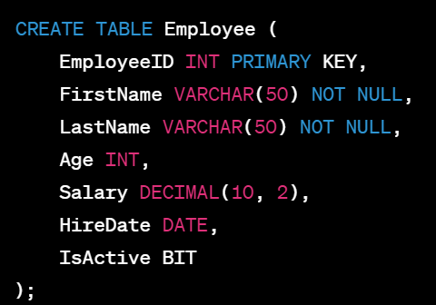
Data Types
Column | Data Type | Example Value
EmployeeID | INT (Integer) | 101
FirstName | VARCHAR(50) | "John"
LastName | VARCHAR(50) | "Smith"
Age | INT (Integer) | 30
Salary | DECIMAL(10, 2) | 55000.00
HireDate | DATE | "2023-07-15"
IsActive | BIT (Boolean) | 1 (true) or 0 (false)

Slide 61
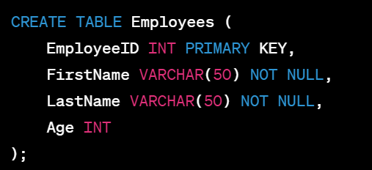
Constraints
PRIMARY KEY Constraint
The PRIMARY KEY constraint uniquely identifies each record in a table. It ensures that the values in the specified column(s) are unique and not null.

Slide 62
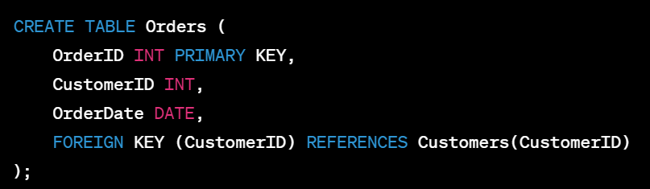
Constraints
FOREIGN KEY Constraint
The FOREIGN KEY constraint establishes a link between two tables, ensuring that the values in a column(s) of one table match the values in the primary key column(s) of another table.

Slide 63
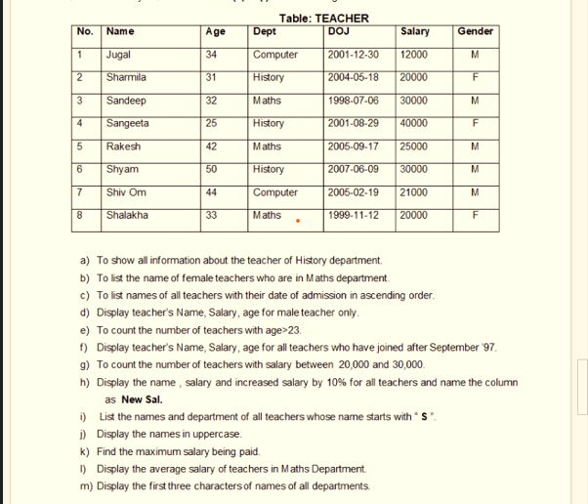

Slide 64
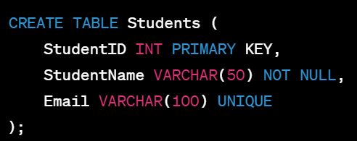
Constraints
UNIQUE Constraint
The UNIQUE constraint ensures that the values in the specified column(s) are unique across the table.

Slide 65
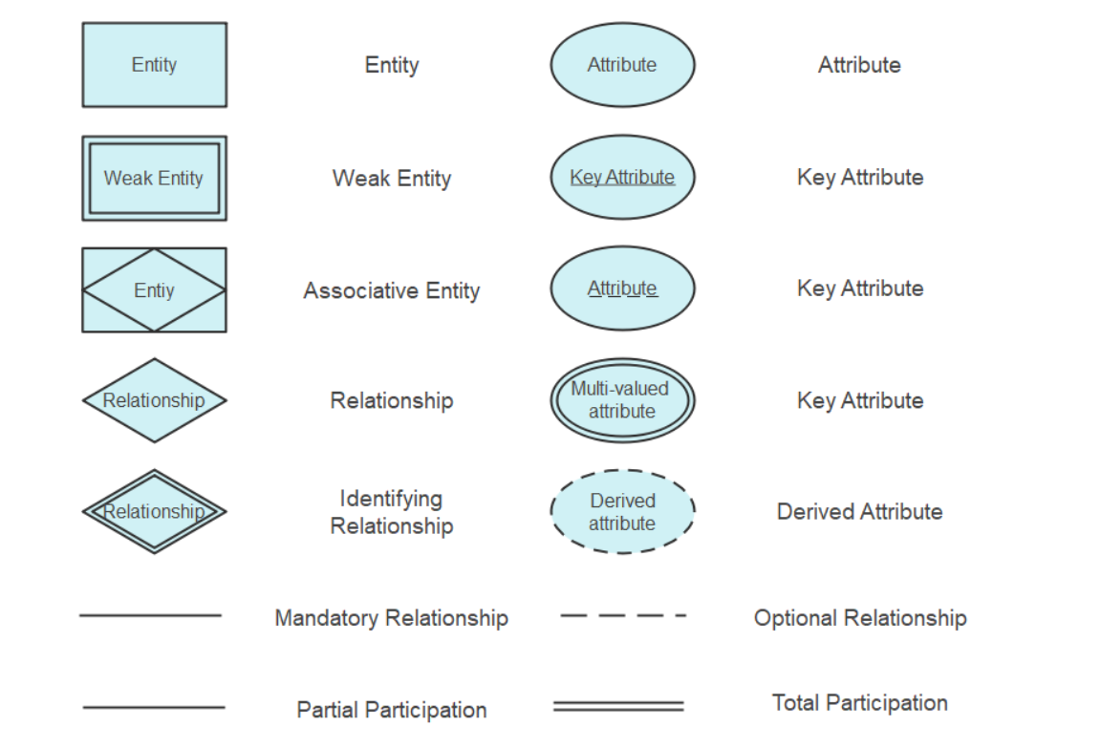
E-R-Diagram Notation

Slide 66
E-R-Diagram
The Entity-Relationship (ER) Model is a high-level data modeling technique used to visually represent the structure of a database. It focuses on how data is logically connected and how entities (things of interest) relate to each other.
Key Components of the ER Model (Employees Database Examples)
1. Entity
An object or concept about which data is stored.
Example: Employee, Department, Project.
Types:
Strong Entity: Exists independently.
Example: Employee (can exist without depending on another entity).
Weak Entity: Dependent on another entity.
Example: Dependent (depends on Employee for existence).

Slide 67
E-R-Diagram
2. Attributes
Characteristics or properties of an entity.
Example: For Employee, attributes could be EmpID, Name, DOB, Email.
Types:
Simple Attributes: Cannot be divided further.
Example: Email.
Composite Attributes: Can be divided into smaller parts.
Example: FullName → FirstName, LastName.
Derived Attributes: Computed from other attributes.
Example: Age (calculated from DOB).
Multivalued Attributes: Can hold multiple values.
Example: PhoneNumbers (an employee may have more than one contact number).

Slide 68
E-R-Diagram
3. Relationships
Associations between entities.
Example: Employee works in Department, Employee assigned to Project.
Types:
One-to-One (1:1): One instance of an entity relates to only one instance of another.
Example: Each Employee is assigned one CompanyCar.
One-to-Many (1:N): One instance of an entity relates to many instances of another.
Example: One Department has many Employees.
Many-to-Many (M:N): Many instances relate to many instances.
Example: An Employee can work on many Projects, and each Project can have many Employees.

Slide 69
E-R-Diagram
4. Keys
Unique identifiers for entities.
Primary Key: Uniquely identifies an entity.
Example: EmpID for Employee.
Foreign Key: Refers to a primary key in another entity.
Example: DeptID in Employee table (refers to DeptID in Department table).

Slide 70
Relational Data Model
One-to-One
One-to-Many
Many-to-Many
Citizen of India
Aadhar Card
Country
Residents
Subjects
Students

Slide 71
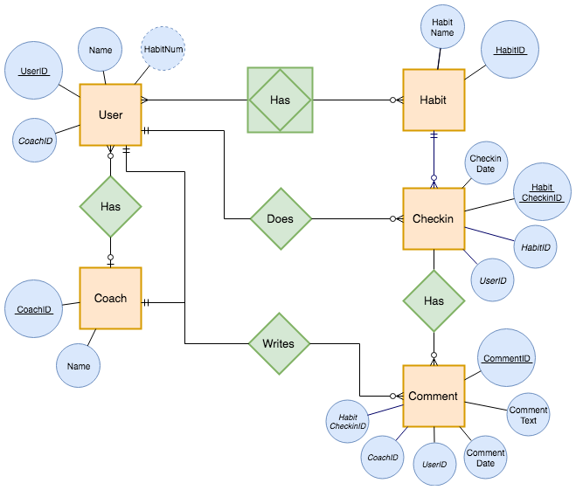
E-R-Diagram

Slide 72
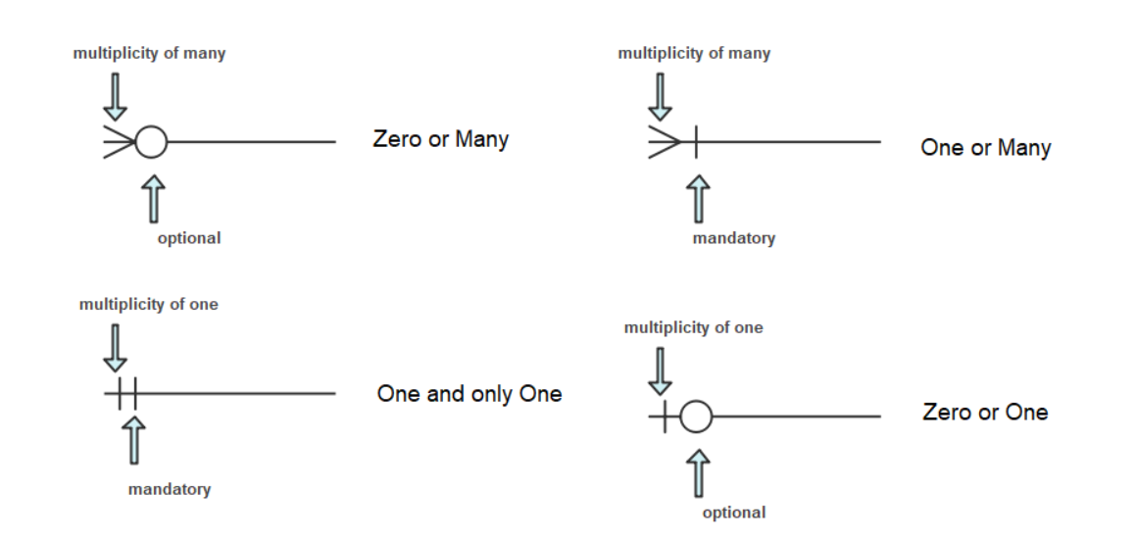
E-R-Diagram

Slide 73
E-R-Diagram
1. Zero or Many
(Symbol: Crow’s foot + open circle)
Meaning: An entity can be related to zero or many instances of another entity.
Example:
Employee — Works on → Project
An employee may not be assigned to any project (zero) or may work on multiple projects (many).
2. One or Many
(Symbol: Crow’s foot + straight line)
Meaning: An entity must be related to at least one instance of another entity, but possibly many.
Example:
Department — Has → Employee
A department must have at least one employee (one) but can have many employees (many).

Slide 74
E-R-Diagram
3. One and Only One
(Symbol: Two vertical bars)
Meaning: An entity must be related to exactly one instance of another entity.
Example:
Employee — Belongs to → Department
Each employee must belong to exactly one department.
4. Zero or One
(Symbol: Single vertical bar + open circle)
Meaning: An entity can be related to zero or one instance of another entity.
Example:
Employee — Has → ParkingSpace
An employee may not have a parking space (zero) or may have exactly one assigned parking space (one).

Slide 75
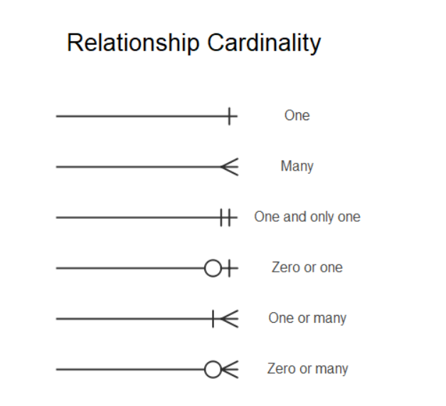
E-R-Diagram

Slide 76
Degree of Relationship
In SQL Server, the "degree of relationship" refers to the number of entity types (tables) that participate in a specific relationship. This concept is particularly relevant in the context of Entity-Relationship (ER) diagrams and database design, where relationships represent associations between entities.
The common degrees of relationships are:
Unary (Degree 1):
A relationship where only one entity type participates. This often occurs in self-referencing relationships, such as an "Employee" table where an employee can be a "Manager" of other employees within the same table.
Binary (Degree 2):
A relationship involving two distinct entity types. This is the most common type of relationship in relational databases. Examples include a "Customer" and "Order" relationship, or an "Employee" and "Department" relationship.

Slide 77
Degree of Relationship
Ternary (Degree 3):
A relationship involving three distinct entity types. These are less common but are used when an association naturally involves three entities. For example, a relationship between "Employee," "Project," and "Client" could be ternary if it represents which employee works on which project for which client.
N-ary (Degree N):
A general term for relationships involving four or more entity types. These are rare and often indicate a need to re-evaluate the database design, as they can become complex to manage and understand.

Slide 78
Entity & Entity Set
Entity and Entity Set
Entity: A real-world object or concept that is distinguishable from other objects.
Example: A Student with specific details like roll number, name, and email.
Entity Set: A collection of similar entities.
Example: The set of all students in a college.

Slide 79
Attributes and Types of Attributes
Attributes describe properties of an entity.
Types of Attributes:
Simple Attribute: Cannot be divided further.
Example: Age.
Composite Attribute: Can be divided into sub-parts.
Example: Full Name → First Name + Last Name.
Derived Attribute: Value can be derived from other attributes.
Example: Age (from Date of Birth).
Multi-valued Attribute: Can hold multiple values.
Example: Phone Numbers.
Key Attribute: Uniquely identifies each entity.
Example: Roll Number.
Null Attribute: Can have no value for some entities.
Example: Middle Name.

Slide 80
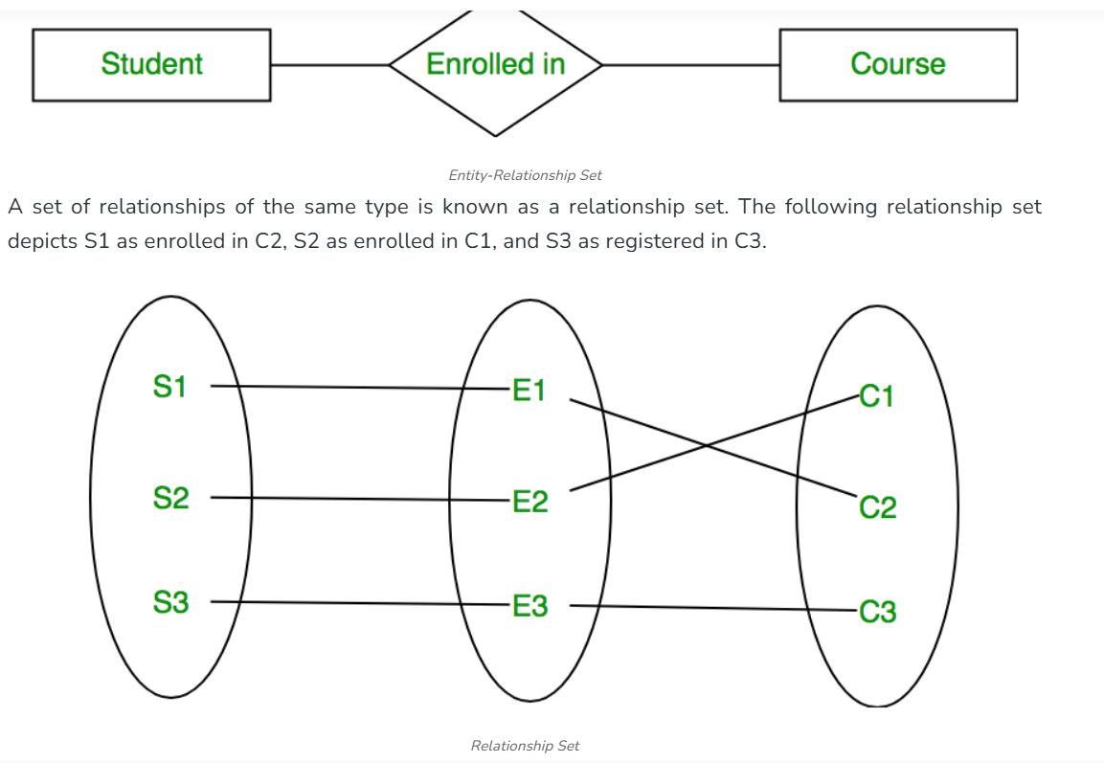
Relationship Sets
.

Slide 81
Relationship Sets
A Relationship Set is a collection of relationships of the same type.
Example: The set of all Enrolled In relationships between students and courses.
Types of Relationships:
One-to-One (1:1) — One entity in set A relates to only one in set B.
One-to-Many (1:N) — One entity in set A relates to many in set B.
Many-to-Many (M:N) — Many entities in set A relate to many in set B.
Degree of Relationship
The degree indicates the number of entity sets involved in a relationship:
Unary (1 entity set): Example — Employee supervises Employee.
Binary (2 entity sets): Example — Student enrolls in Course.
Ternary (3 entity sets): Example — Doctor prescribes Medicine to Patient.

Slide 82
Constraints
CHECK Constraint
The CHECK constraint enforces a condition on the values allowed in a column(s).
CREATE TABLE Employees (
EmployeeID INT PRIMARY KEY,
FirstName VARCHAR(50) NOT NULL,
LastName VARCHAR(50) NOT NULL,
Age INT,
Department VARCHAR(50) CHECK (Department IN ('HR', 'IT', 'Finance', 'Marketing'))
);

Slide 83
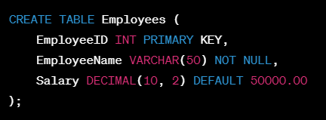
Constraints
DEFAULT Constraint
Specifies a default value for a column when new row is inserted, in case the value for that column is not provided.

Slide 84
CREATE TABLE
To create a table, you must provide a name for the table, and the names and data types of each column in the table.
It is also a good practice to indicate whether null values are allowed in each column.
CREATE TABLE dbo.Products
(ProductID int PRIMARY KEY NOT NULL,
ProductName varchar(25) NOT NULL,
Price money NULL,
ProductDescription varchar(max) NULL)
GO

Slide 85
INSERT INTO TABLE
ProductID | ProductName | Price | ProductDescription
1 | Clamp | 12.48 | Workbench clamp
50 | Screwdriver | 3.17 | Flat head
75 | Tire Bar |  | Tool for changing tires.
3000 | 3 mm Bracket | 0.52
INSERT dbo.Products (ProductID, ProductName, Price, ProductDescription)
VALUES (1, 'Clamp', 12.48, 'Workbench clamp')
GO

Slide 86
Data Control Language
The two primary DCL commands are:
GRANT: This command is used to provide specific privileges or permissions to a user or role on a database object (like a table, view, or procedure).
REVOKE: This command is used to remove previously granted privileges or permissions from a user or role.
GRANT SELECT, INSERT ON employees TO user1;
REVOKE INSERT ON employees FROM user1;
GRANT grants user1 the ability to SELECT (read) and INSERT (add new rows) data in the employees table.
REVOKE removes the INSERT privilege from user1 on the employees table.

Slide 87




Why Relational Database are Important?
Structured and Data Management
Eliminates Data Redundancy
Efficient Querying With SQL
Ensures Data Security

Slide 88

Schema
Defines the structure of a database
Includes tables, columns, data types and relationships
Example:
A University Database Schema may include:
Students Table – to Store student details
Courses Table – to Store course information
And Enrollments Table – to store details of student-course enrollments.
Student Table
Courses Table
Enrollment Table

Slide 89
Schema
A schema in SQL Server is just a logical container for tables, views, procedures, etc.
By default, all objects go into the dbo schema unless you specify another.
How to create a schema:
CREATE SCHEMA HR;
How to use it:
CREATE TABLE HR.Employee (EmployeeID INT PRIMARY KEY,Name VARCHAR(100) );
Schemas in SQL Server Management Studio (SSMS):
Open SSMS and connect to your database.
In Object Explorer, expand your database.
Expand the Security folder.
Inside, you’ll see a Schemas folder — this lists all schemas like dbo, sys, and any you create.
If you don’t want to create custom schemas, just keep using dbo.

Slide 90
LIMIT Clause
Used to restrict the number of rows returned by a query
Useful in pagination, testing queries, or viewing sample data
Without overloading the terminal
Syntax:
SELECT * FROM table_name LIMIT number;
Example:
SELECT * FROM employees LIMIT 5;
Often paired with ORDER BY
Especially to fetch top entries based on a condition

Slide 91
Thinknyx Technologies LLP
Comparison, Logical and Arithmetic Operators

Slide 92
Comparison Operators
=
!=
<
>
<=
>=
They’re used in WHERE clause to compare column values
Returns a boolean result — either TRUE, FALSE, or NULL
Copyright © Thinknyx Technologies LLP

Slide 93
Logical Operators
Logical operators help us filter records by combining multiple conditions using AND, OR, & NOT.
AND
OR
NOT
Ensures that all conditions must be true for a row to be returned
Returns rows where any one of the conditions is true
Used to negate a condition. It will return rows where the condition is not true
Powerful when used with the WHERE clause, especially when dealing with large datasets
Copyright © Thinknyx Technologies LLP

Slide 94
Logical Operators
AND
OR
narrows the results
broadens the results
It needs all conditions to be true
It works if even one condition is true

Slide 95
Arithmetic Operators
+
-
*
/
%
addition, subtraction, multiplication, division, and modulus

Slide 96
Thinknyx Technologies LLP
String Functions & Operators

Slide 97
String Functions
~ sequence of characters
String
Names
Email addresses
Text data
~format, analyze, or clean the strings in our queries
Built-in string functions

Slide 98
String Functions
UPPER()
LOWER()
Converts all characters in a string to uppercase
Converts the entire string to lowercase
UPPER()
Command:
SELECT UPPER('hello world');
Output:
HELLO WORLD
LOWER()
Command:
SELECT LOWER('HELLO WORLD');
Output:
hello world
Example:

Slide 99
String Functions
LENGTH()
Returns the number of characters in a given string
SELECT LENGTH('PostgreSQL');
Output:
10
Example:

Slide 100
String Functions
CONCAT()
Joins two or more strings into a single continuous string
SELECT CONCAT('Alice', ' ', 'Johnson');
Output:
Alice Johnson
Example:
Copyright © Thinknyx Technologies LLP

Slide 101
String Functions
SUBSTRING()
Extracts a part of a string based on the position you specify
SELECT SUBSTRING('alex@company.com' FROM 1 FOR 5);
Output:
alex@
Example:
Copyright © Thinknyx Technologies LLP

Slide 102
String Functions
TRIM()
Used to clean up text by removing unnecessary spaces from the beginning and end of a string
SELECT TRIM(' Hello World ');
Output:
Hello World
Example:
Copyright © Thinknyx Technologies LLP

Slide 103
LIKE, BETWEEN, IN, NOT IN, EXISTS (Operators)

Slide 104
LIKE Operator
LIKE
Used to search for a specific pattern in a text column
Names starting with a Certain letter
Email domains
Values containing a keyword
The % symbol is a wildcard that matches any number of characters
The _ underscore sign represents one, single character
SELECT 'Apple' LIKE 'A%';
Output:
true
Example:

Slide 105
BETWEEN Operator
BETWEEN
Filtering numbers or dates within a range
Numbers
Dates
Text
It includes both the lower and upper bounds
SELECT 75 BETWEEN 50 AND 100;
Output:
true
Avoids the need for chaining >= and <=
Example:

Slide 106
Date Functions
BETWEEN
Filtering numbers or dates within a range
Numbers
Dates
Text
It includes both the lower and upper bounds
SELECT 75 BETWEEN 50 AND 100;
Output:
true
Avoids the need for chaining >= and <=
Example:

